Slide 1
EART30351
Lecture 8

Slide 2
Recap
Horizontal convergence and divergence determine patterns of vertical velocity on the synoptic scale
C and D are mainly a property of the ageostrophic wind
Ageostrophic wind is proportional to acceleration
Jet stream sets up C and D at entrance and exit

Slide 3

Directional acceleration
Circular flow around a low pressure centre (NH)
Consider balance of forces
$$\frac{dU}{dt}=−∇Φ−fk×U$$
Centripetal acceleration = U²/R towards centre
= (U/R)$k×U$
So:
$$\frac{U}{R}k×U=−∇Φ−fk×U$$
$$\left(\frac{U}{R}+f\right)U=k×∇Φ=fU_{G}$$
U
Co
Acc^{n} = $\frac{U^{2}}{R}$
P
pgf
R
$$k×k×=−1$$

Slide 4
Gradient Wind Equation
$$\left(\frac{U}{R}+f\right)U=k×∇Φ=fU_{G}$$
U and U_{G} must be collinear
So we have a scalar equation
$\frac{U^{2}}{R}+fU−fU_{G}=0$
This is called the gradient wind equation, and is solved using the usual quadratic formula
Clearly, for positive R, U < U_{G}
wind around a low is slower than geostrophic

Slide 5
Flow around a High Pressure
Circular flow around a high pressure centre (NH)
Consider balance of forces
Centripetal acceleration = U²/R towards centre
= -(U/R)$k×U$
So:
$$\frac{−U}{R}k×U=−∇Φ−fk×U$$
We can use the same maths as before if we define R to be negative around a high. Then:
$\frac{U^{2}}{R}+fU−fU_{G}=0$
in both cases, but when R<0, U>U_{G} – wind around a high is faster than geostrophic
U
Acc^{n} = $\frac{U^{2}}{R}$
pgf
P
Co
R

Slide 6
Trough-ridge pattern in the jet stream
U > U_{G}
So U_{A} > 0
Ridge, R<0
Trough, R>0
U < U_{G}
So U_{A} < 0

Slide 7
Trough-ridge pattern in the jet stream
Straight flow, so U = U_{G} , U_{A} = 0
U > U_{G}
So U_{A} > 0
U_{A}
Ridge, R<0
Trough, R>0
U_{A}
U < U_{G}
So U_{A} < 0

Slide 8
Trough-ridge pattern in the jet stream
Straight flow, so U = U_{G} , U_{A} = 0
U_{A}
C
U_{A}
D
Undulations in the jet stream are called Rossby waves.
Rossby waves set up patterns of convergence and divergence due to change in direction of the flow
C forces downward motion, D forces upward motion in the troposphere

Slide 9
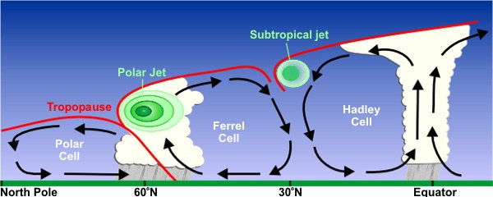
Jet streams and fronts
Why do we have jet streams? Jet streams are linked to fronts – horizontal temperature gradients
Source: wikipedia

Slide 10
Vertical wind shear, ∂U/∂p
Consider the vertical gradient of the geostrophic wind:
$$U_{G}= \frac{1}{f}k×∇Φ$$
$$U_{G}= \frac{g}{f}k×∇_{p}z$$
where z is geopotential ht $\frac{∂U_{G}}{∂p}$ = $\frac{g}{f}k×∇_{p}\frac{∂z}{∂p}$
But ∂p/∂z = -ρg = -pg/rT
$\frac{∂U_{G}}{∂p}$ = $−\frac{r}{fp}k×∇_{p}T$
$\frac{∂U_{G}}{∂lnp}$ = $−\frac{r}{f}k×∇_{p}T$
An alternative form may be derived using
$$\frac{∂U_{G}}{∂z}=\frac{∂U_{G}}{∂p}\frac{∂p}{∂z}=−\frac{pg}{rT}\frac{∂U_{G}}{∂p}$$
$\frac{∂U_{G}}{∂z}$ = $\frac{g}{fT}k×∇_{p}T$
These are both forms of the thermal wind equation

Slide 11
Effect of thermal wind equation
In the troposphere, ∇T points equatorward.
So k x ∇T points eastwards in both hemispheres.
So, westerly winds increase with height (∂u/∂z>0) in the troposphere.
The equator-pole temperature gradient is concentrated at fronts – giving local maxima in westerly wind near the tropopause which we call jet streams

